Slide 1

First look at the datasets in Spotlight

Slide 2
GOAL
The goal of this analysis is to have a preliminary view on the datasets that come with the Spotlight library so that we can gain insights on the data.
We want to explore the different data distributions, find correlations between different features and detect possible anomalies (like outliers) if there are any.
The data we will use for the analysis consists on a sample from the datasets (as explained in the documentation). The two main dataset the we are exploring are the ‘ratings’ and the ‘metadata’ datasets.

Slide 3
STEPS
To conduct this analysis we will follow these steps:
Consider the basic metrics of the data base
Explore relationships between different features using scatter plots
Explore the distribution of some features using bar charts
Explore frequency of different features using wordclouds
With these visualizations, we hope to be able to extract meaninful and relevant information and to be able to generate insights from the data.

Slide 4
1. Basic metrics of the data
The ‘ratings’ dataset only contains information about users and ratings.
In our ‘ratings’ subset, we have 100.004 entries for different ratings.
When taking the avarage rating for each movie in the data set, we can see that:
There are 300 movies rated in mean score of top value 5.
There are 89 movies rated with a mean score less than 0.5

Slide 5
1. Basic metrics of the data
The ‘metada’ dataset contains information about movies, for example, its budget, genre, popularity, etc.
In our ‘metadata’ subset, we have information of 45466 different movies.
We will use the movie features to explore relationships in the next section.

Slide 6
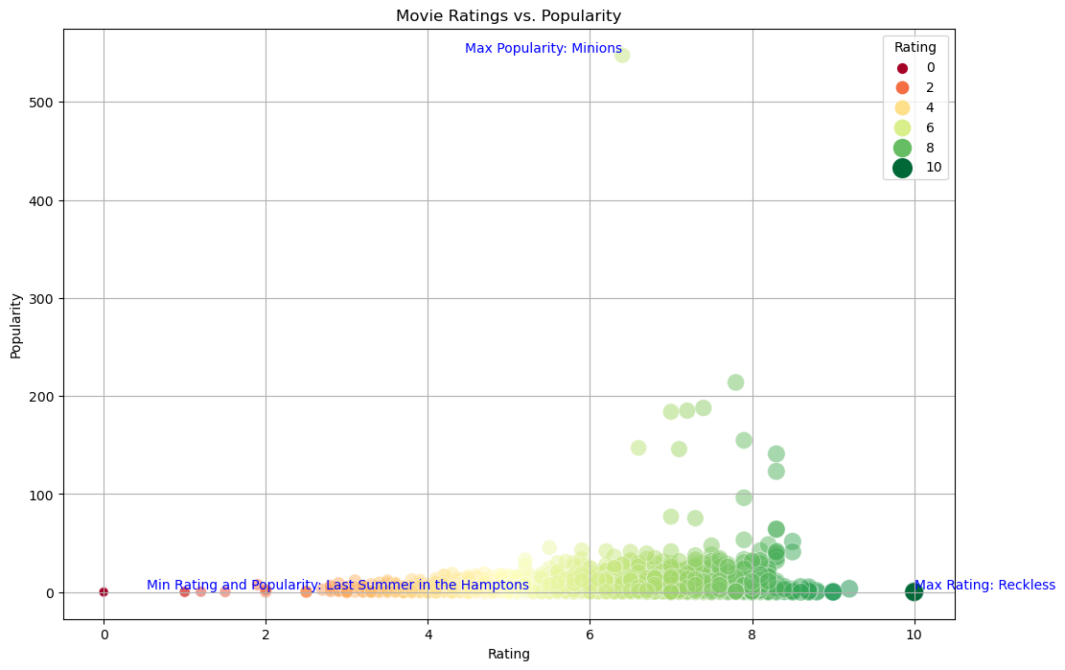
2. Scatter plots
We have selected some features from the ‘metadata’ dataset that we think can show correlations.
Popularity vs. Rating:

Slide 7
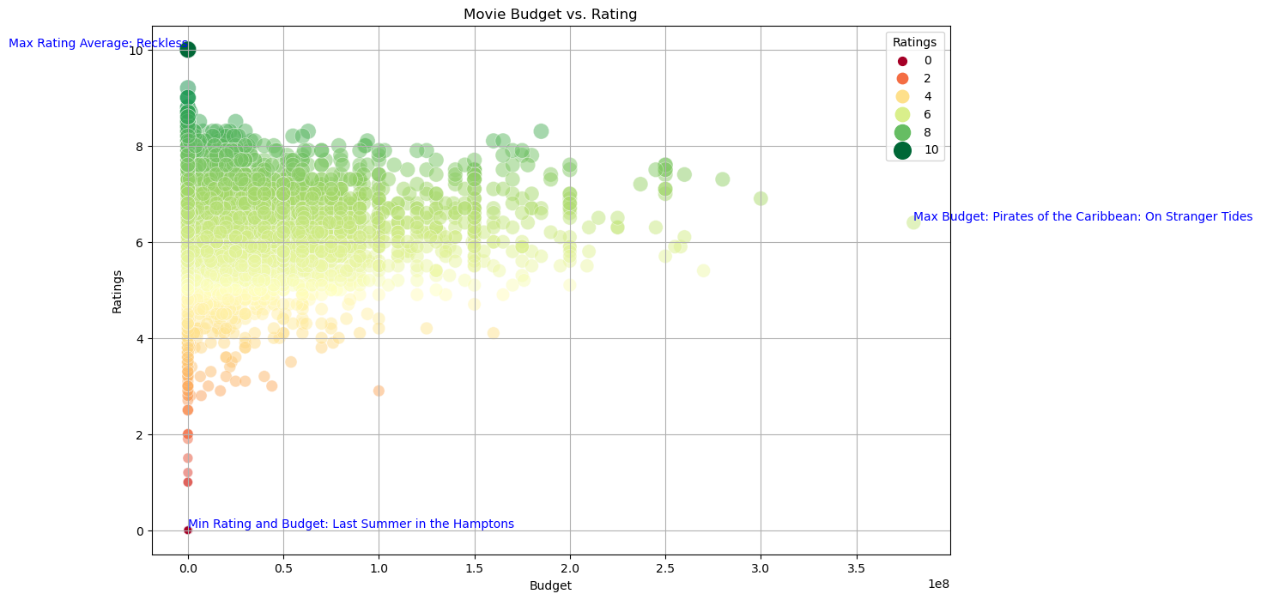
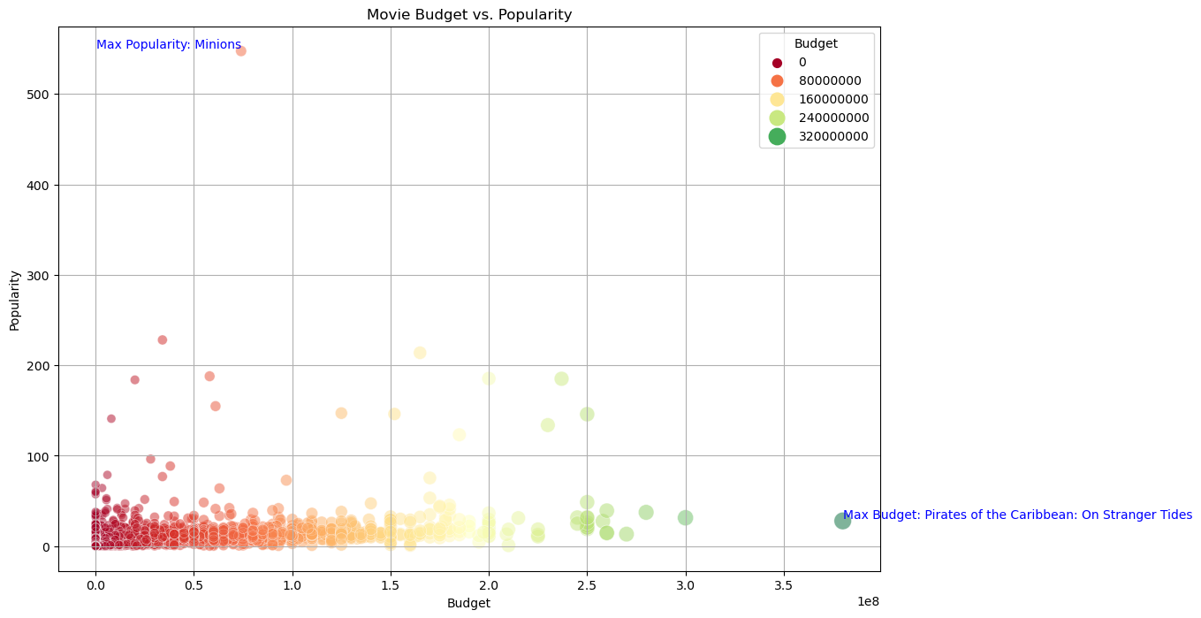
2. Scatter plots
Budget vs. Rating
Budget vs. Rating

Slide 8
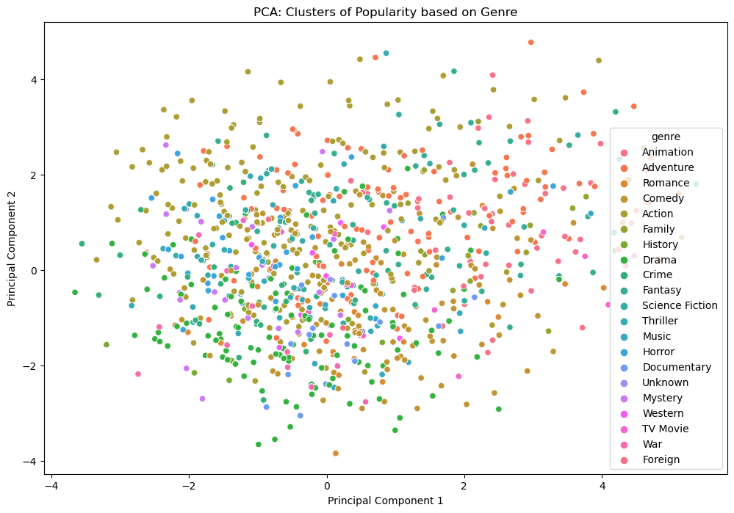
2. Scatter plots
Finally, to explore correlations, we have performed a PCA with to components, the popularity and the genre of a movie

Slide 9
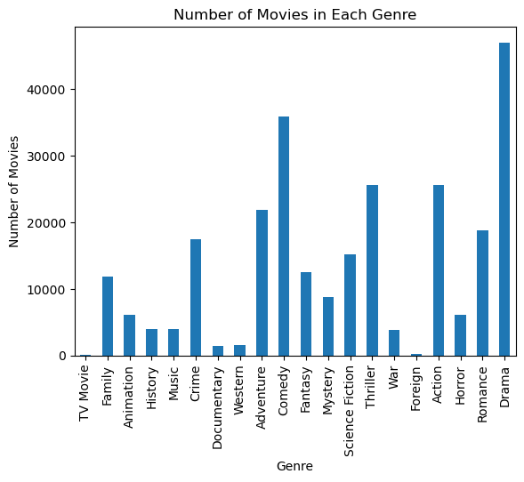
3. Bar chart
Using a bar chart, we can see the distribution of the feature genre of the movie:

Slide 10
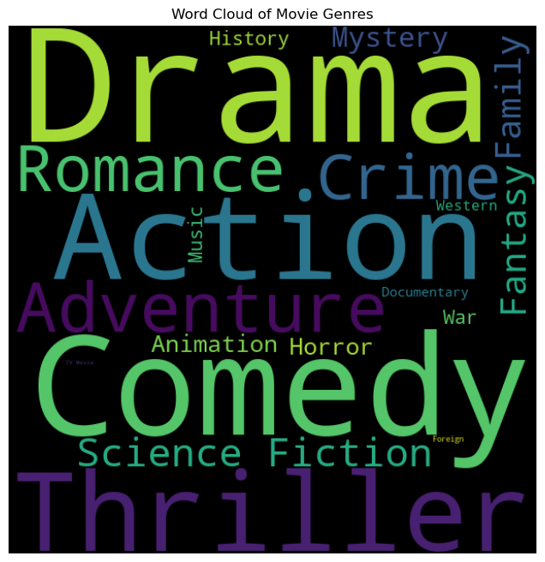
4. Wordclouds
In a similar way, we can see the frequency for the feature genre using a wordcloud

Slide 11
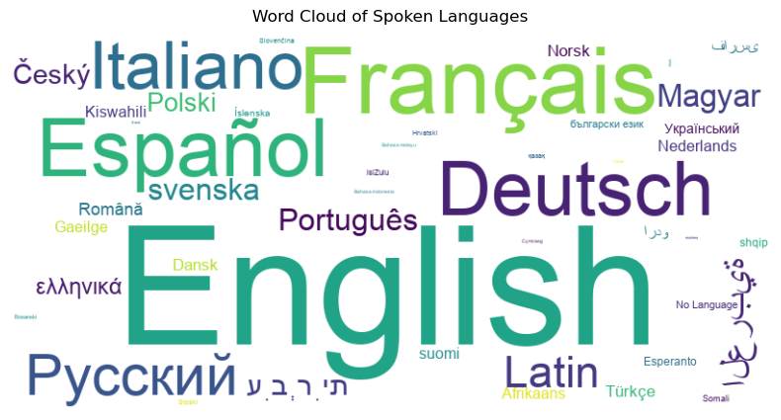
4. Wordclouds
Finally, we take a look into the frequency of the different languages used in the dataset.

Slide 12
Conclusions
The ‘metadata’ dataset holds a lot of information. We don’t see a clear correlation between ratings of the movie and its popularity, since there are movies with high ratings and low popularity.
The situation is similar for the correlation between the ratings and the movie budget. We can’t conclude that there is a clear correlation since there are movies with low budget but high ratings.
In contrast, we can say there is a correlation between the budget and the popularity of the movie, since there seems to be a slight growing tren between these two features.
In the PCA, we do not observe any separeted cluster, meaning, we cannot extract a rules that relates popularity to the genre of the movie.

Slide 13
Conclusions
About outliers: in the scatter plots we can see how the movie ‘Minions’ is an outlier for its really differenciated mark on popularity.
Also, we could find that the dataset is a bit unbalanced since there are many more Drama movies that other genres. When training we should ensure the model is not biased towards this, if we end up using 'genre' as a learning feature. We can see this in the bar chart and the first wordcloud.
Lastly, we see that English, Espanigh, French and German are the most frequent languages in the dataset. Yet, some other languages are used to. We will need to have this in mind to look for special characters in the movie titles.

Slide 14
Conclusions
Finally we want to mention, that this preliminary analysis has been helpful and has provided us with various insights on the data.
The main analysis was done on the ‘metadata’ dataset because it contains the most features, yet, this data is not directly used in the training of the models.
Finally, we can say that we have found some anomalies and other things to take into account when we train our models.

